Slide 1
Patient Selection
Patient selection issues as an increasing claims driver in
dental malpractice cases
Punjabi Dental Society
January 26, 2025
Jacqueline Clarke, J.D.

Slide 2
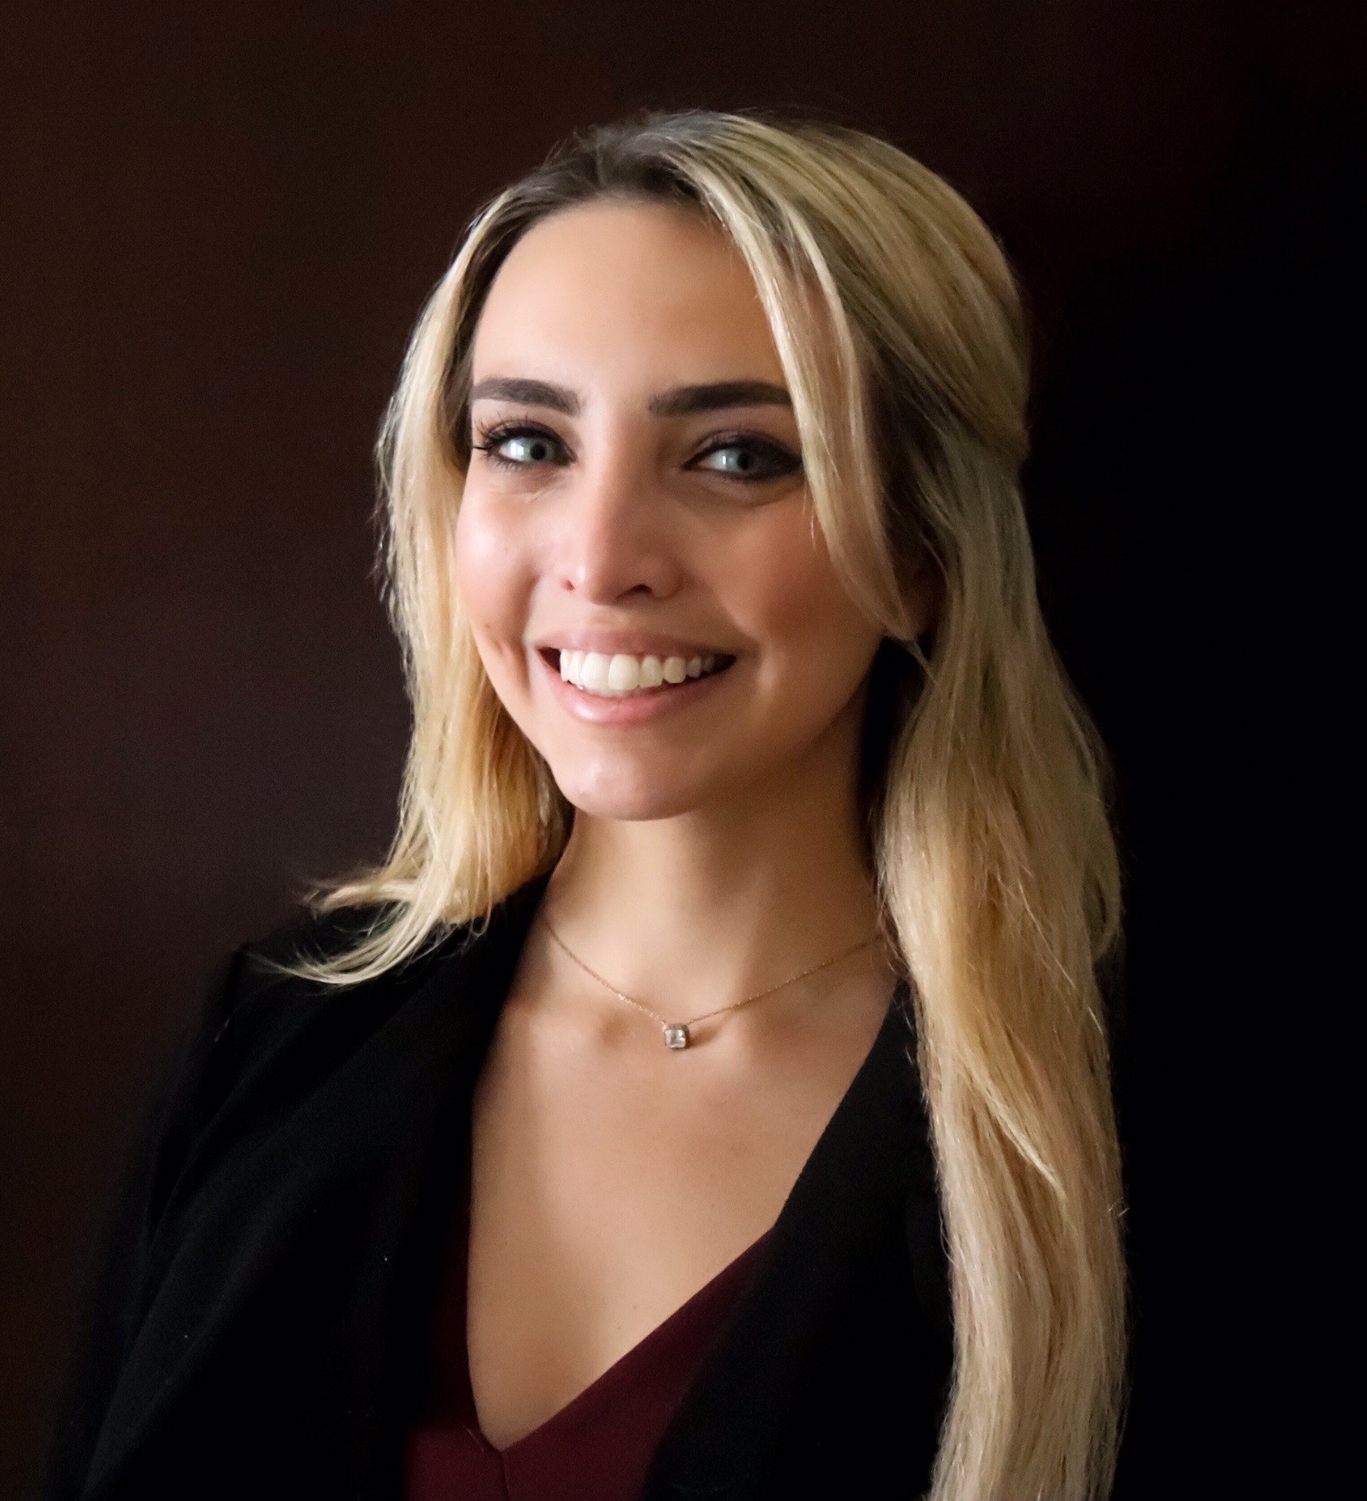
Speaker Bio
Jacqueline Clarke, J.D. Lead Senior Risk Consultant and Dental Claims Consultant, MedPro Group (Jacqueline.Clarke@medpro.com; 248-216-0644)
Jacqueline Clarke received her BA in Literature and Film from Kalamazoo College in 2010, and her Juris Doctorate from Michigan State University College of Law in 2013. She is admitted to practice law in both the Michigan and Illinois state courts, as well as the United States District Courts for the Eastern and Western Districts of Michigan.
Before joining MedPro Group, she worked as a litigation attorney at Smith, Haughey, Rice & Roegge in Ann Arbor, Michigan. There, she specialized in the defense of hospitals, healthcare facilities, physicians, nurses, and dentists in all stages of the licensing, claims, and litigation processes. She also provided risk management consultative services to a number of institutional clients, including the University of Michigan Health System, Spectrum Health, and Beaumont Health.
Jacqueline joined MedPro in 2018 and helped our dental division achieve a trial win rate of 95% and a closed without payment rate over 80%. Jacqueline’s responsibilities include developing and delivering risk management and patient safety services to MedPro-insured dentists, students, and national dental organizations. Jacqueline also serves in a business development role by providing educational seminars on risk reduction and proactive risk management to prospective clients, distribution partners and dental students.

Slide 3
Disclaimer
The information contained herein and presented by the speaker is based on sources believed to be accurate at the time they were referenced. The speaker has made a reasonable effort to ensure the accuracy of the information presented; however, no warranty or representation is made as to such accuracy. The speaker is not engaged in rendering legal or other professional services. The information contained herein does not constitute legal or medical advice and should not be construed as rules or establishing a standard of care. Because the facts applicable to your situation may vary, or the laws applicable in your jurisdiction may differ, if legal advice or other expert legal assistance is required, the services of an attorney or other competent legal professional should be sought.

Slide 4

Objectives
At the conclusion of this program, participants should be able to:
Discuss the potential problems or pitfalls in patient
selection
Identify best practices in the patient selection
process
Analyze case studies for lessons learned
Understand the significance of patient selection as a dental malpractice claims driver

Slide 5
Key Definitions

Slide 6
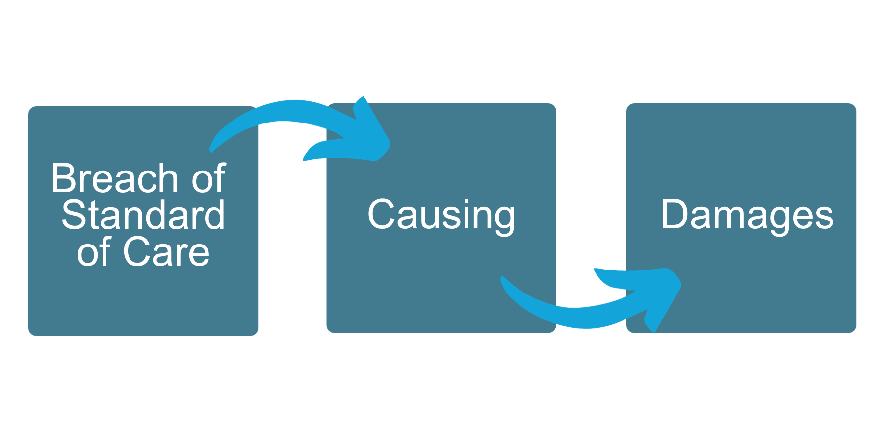
Professional Malpractice—Definition
When a medical professional provides care that diverges from what is accepted as the standard of care as recognized by the medical community, which directly causes damages.

Slide 7
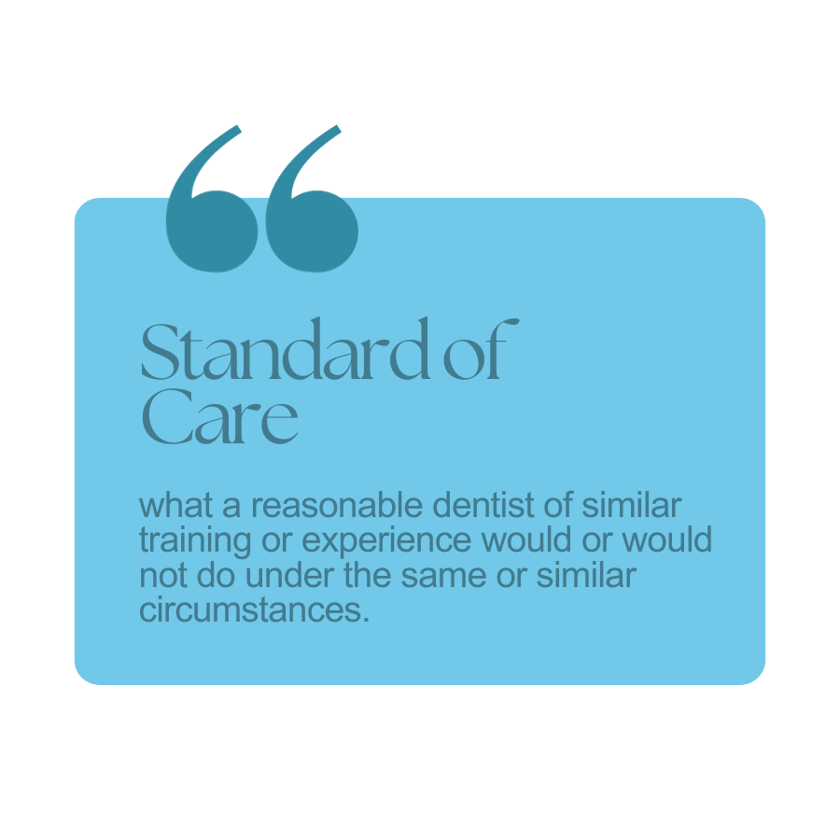
Who or What Determines the Standard of Care?

Slide 8


Standard of Care Determined by Expert Opinions
  Experts for plaintiff and defendant always have differing opinions.
  Basis for opinions must be scientific . . . not "junk science."
  Jurors may seek no outside information from people, journals, internet, broadcast media, etc.
  The jury is made up of laypeople (usually with no medical background), thus . . .
Ask 10 dentists the same question and you'll get 10 different opinions.
Likability & Credibility are Everything

Slide 9
MedPro Claim Study and Database

Slide 10
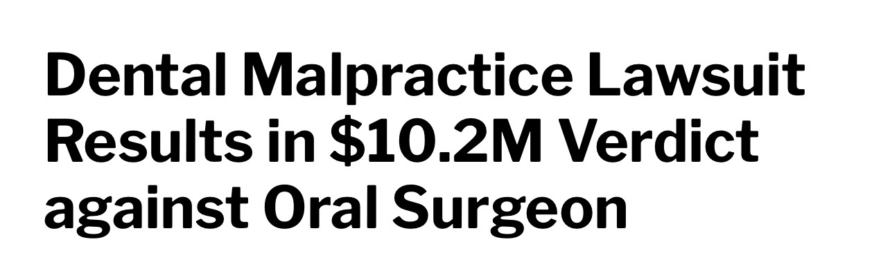
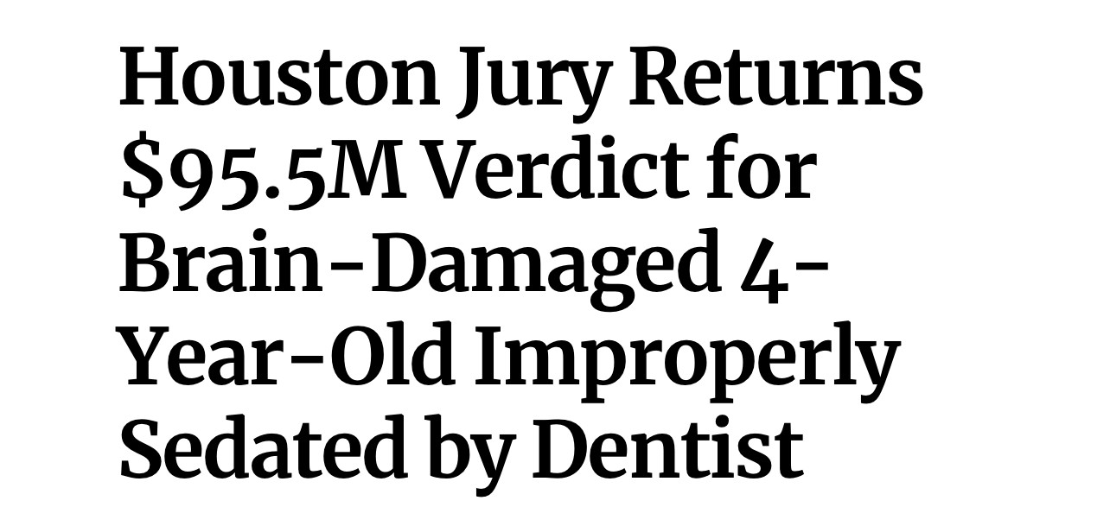
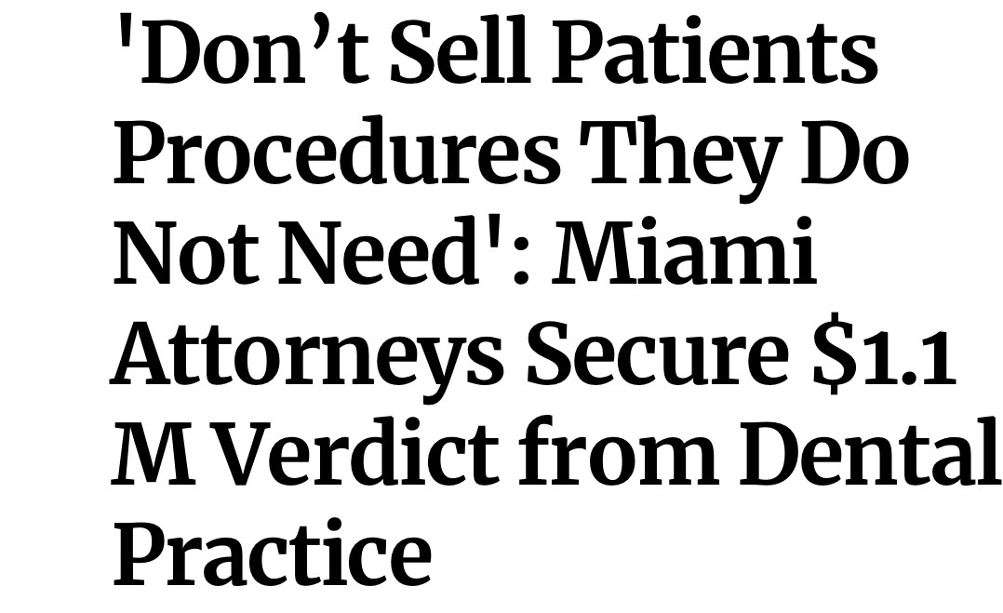
Today's Malpractice Environment
Dental claims frequency is rising after a decade of steady decrease.
Dental claims severity is also rising significantly:
  Average claim in mid-1990s = $19k.
  Average claim in mid-2000s = $39k.
  Average claim in 2023 ≈ $121k.
Social inflation is contributing to the severity trend.
Plaintiff Attorneys are focusing on the service side of dentistry, to push the severity trend.

Slide 11
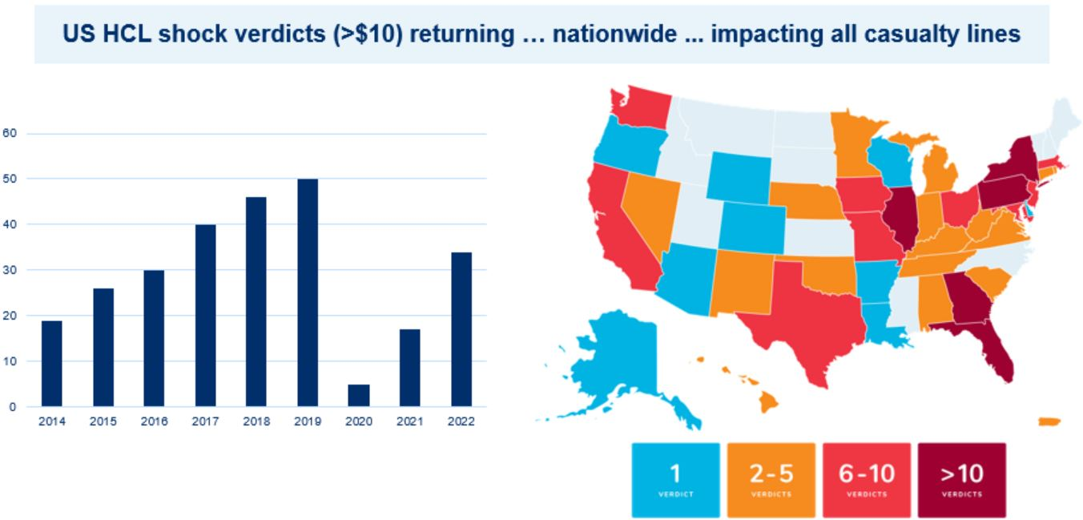
Increasing "Shock" Verdicts Nationwide

Slide 12
Definitions
Indemnity
is defined as the payment(s) made to a party for a loss. These payments are typically made as a settlement or based on a jury verdict and award.
is defined as a suit, claim, or notice of intent when the patient has placed a dentist on notice.
Claim
is defined as the cost of a claim in terms of indemnity payment(s). This is a monetary term and not specifically attributed to the severity of a medical outcome.
is defined as the number of claims.
Severity
Frequency

Slide 13
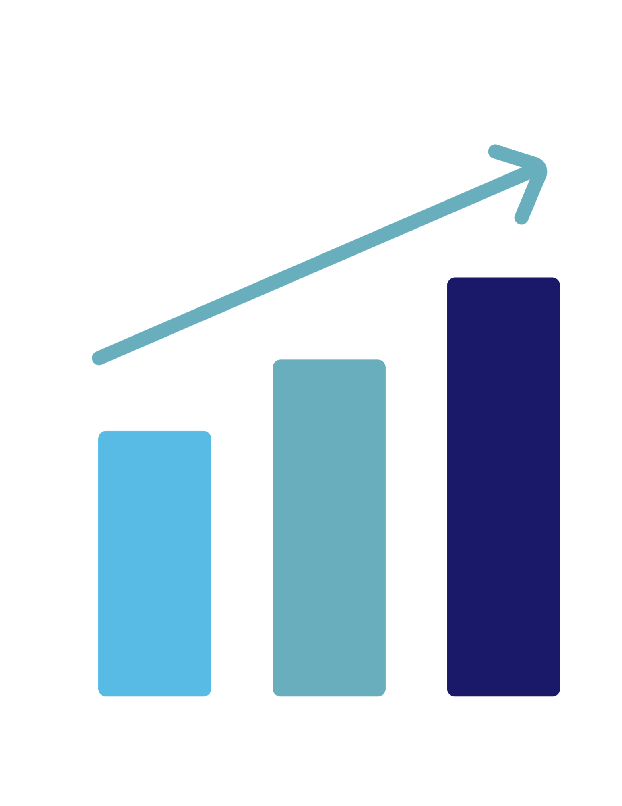
MedPro Dental Malpractice Claim Study and Database
Assessment of closed claims from 2009 – 2023.
Includes every claim with indemnity greater than $50K.
Severity is Rising:
  2009: There were 45 claims that met the $50k threshold
  2023: There were 152 claims that met the $50k threshold
Our study represents in excess of $207,368,086 in indemnity and expense payments.

Slide 14
Claim Study: Most Common Dental Procedures
Five most common procedures* - accounting for 75% of all cases
Five most expensive procedures** - accounting for 71% of total dollars paid
Implants (17.6%)
Crowns (17.1%)
Non-Third Molar Extractions (15%)
Root Canals (13%)
Third Molar Extractions (12.2%)
Crowns / Fillings (16.4%)
Implants (15.6%)
Non-Third Molar Extractions (15.2%)
Root Canals (12%)
Third Molar Extractions (11.9%)
Data source: MedPro Group dental cases closed with >/= $50,000 total dollars paid (expense + indemnity), 2009-2023 (N=1,296)

Slide 15
5 Most Common Risk Factors—Claim Drivers
Inadequate Documentation (42.2% of case volume; 49.6% of total dollars paid)
Patient Communication Deficiencies (25.6% of case volume; 29.02% of total dollars paid)
Patient Selection (25.3% of case volume; 25.86% of total dollars paid)
Informed Consent (23.3% of case volume; 22.57% of total dollars paid)
Jousting (18.5% of case volume; 19.41% of total dollars paid)
Data source: MedPro Group dental cases closed with >/= $50,000 total dollars paid (expense + indemnity), 2009-2023 (N=1,296)

Slide 16
Claims Drivers Increasing Trends

Slide 17
Patient Selection Cases
statistics

Slide 18

Patient Selection Cases—Increasing Severity
total $ paid
$165k

Slide 19
Most Common Procedures – Patient Selection Issues
Bridges
5.86%
Orthodontia
6.17%
General Dental Care
6.8%
24.38%
Root Canal
8.3%
Extraction—3rd Molars
8.3%
Crowns / Fillings
17.9%
Extraction—Non-3rd Molars
15.4%

Slide 20
Most Frequent + Severe Injuries – Patient Selection Issues
Most Frequent Categories of Injuries
Periodontal Issues (11.1% of case volume; 7.37% of total dollars paid)
Implant Failure (8.95% of case volume; 6.1% of total dollars paid)
Open Margins Requiring Re-Do (8.64% of case volume; 5.8% of total dollars paid)
Most Severe Categories of Injuries
Osteonecrosis (10.4% of total dollars paid; 4.6% of case volume)
Anesthesia—Death (7.45% of total dollars paid; 2.78% of case volume)
Infection (7.45% of total dollars paid; 7.71% of case volume)
Data source: MedPro Group dental cases closed with >/= $50,000 total dollars paid (expense + indemnity), 2009-2023 (N=1,296)

Slide 21
Patient Selection Cases – Generally
Associated with cases involving documentation-related issues 23% more often than with other contributing risk factors.
Noted most often in implant-related cases. Implant cases with patient selection issues are, on average, 65% more expensive to resolve than all implant cases.
Account for 25.3% of all cases and 25.86% of total dollars paid.
Data source: MedPro Group dental cases closed with >/= $50,000 total dollars paid (expense + indemnity), 2009-2023 (N=1,296)

Slide 22
Patient Selection
introduction

Slide 23
Patient Selection Cases – Generally
Think of the 5 patients in your practice who stress you out the most just by seeing their names on the schedule?
Who are they?
What can you do about them?
If you received a claim or lawsuit from them . . . would you be surprised?

Slide 24

Recognizing the "Difficult Patient"
Cosmetic Procedure Patients (e.g. crowns, veneers, ortho)
Emergency Patients
Second-Opinion Patients
Nonadherent Patients
Disruptive, Abusive Patients

Slide 25
Cosmetic Patients

Slide 26
Patient Selection: Case study #1
Case st dications
Patient
Summary
Outcome
46 YOF patient, A, presented to general dentist, Dr. B, for new crowns for aesthetic purposes. She advised she had seen 3 prior dentists for crown consults, but found each of their work to be "unsatisfactory." She advised she hoped work with Dr. B would be different.
A treated with Dr. B for 1 year 9 months. A wanted new crowns at #s 6, 7, 9, 26, 27, and 28. At each try-in, A would complain about the color, shape & fit of the crowns. Dr. B re-made the crowns 6 separate times, at each point, placing temporaries only for A to request they be remade. Oftentimes, A would go home in temporaries, and then call on the weekend, demanding she be seen to have the crowns re-made.
A finally agreed to have the 6th set cemented. Soon thereafter, #9 fractured.
During her time in tx, A fell behind on paying her bills. Dr. B did not charge her multiple appointments and versions of her crowns. When #9 fractured, Dr. B re-made the crown. However, Dr. B demanded payment for all of A's outstanding bills prior to placing the 7th version of the #9 crown. A refused, and sued, claiming, in part, that Dr. B was "holding crown #9 hostage."
Issues?

Slide 27
Patient Selection: Case study #1
Documentation
What were A's expectations?
Why didn't she like the crowns?
What was changed between each crown version?
Initial "Red Flags"
Patient A advised she had 3 prior treaters, and found their work to be "unsatisfactory."
Getting 2nd and 3rd opinions is sometimes okay, but the extent + commentary should have alerted Dr. B that A could pose some additional challenges.
Patient Payment
How to handle patients who don't want to pay and threaten legal action?

Slide 28

The Cosmetic Patient
Purely cosmetic dentistry attracts patients that tend to be:
More critical of the results they receive
Heightened expectations
More vocal about dissatisfaction
More apt to request refunds
More willing to file board complaints, malpractice cases, and negative reviews
Body Dysmorphic Disorder
Dentists should be aware of patients seeking cosmetic dental procedures who might have body dysmorphic disorder (BDD). Patients who have BDD often fixate on minor or perceived defects, and they generally are unsatisfied with the results of cosmetic procedures.
Notes:
Cosmetic dentistry is a needed and desired area of dentistry, but it tends to draw a difficult patient population. You tend to have a patient who is:
More critical of the results
More demanding in terms of what they want
Vocal about dissatisfaction
Apt to request refunds
Litigious – they are definitely apt to file Board Matters and Negative reviews.

Slide 29


Cosmetic Patients—Why the Issues?
”Beauty” defined differently
Unrealistic expectations
Function may be impacted negatively
The endpoint might be a moving and problematic target.

Slide 30
The Cosmetic Patient—Communication is Key
Before deciding to begin cosmetic tx, you need to determine—
What are the patient's expectations?
Patient history is important—be aware of all medical comorbidities + mental health issues
Has patient sought treatment with prior dentists for cosmetic work? Was this prior work successful? Why or why not?
Are the patient's expectations feasible?
Is the desire for cosmetic dentistry related to patient's occupation or an upcoming life event? (Ticking Time Bomb Theory)
Why does the patient want cosmetic dentistry at all?
Why does the patient want cosmetic dentistry now?
Notes:
25-cosmetic-dentistry.pdf

Slide 31
Patient Selection: Case study #2
Case st dications
Patient
Summary
54 YOF patient, A, presented to Dr. B and wanted new crowns at #6-11. A requested a "big, bright, beautiful smile." A's surrounding teeth had some staining, and were darker.
Dr. B prepped A's teeth and discussed with her crown shade. A advised she wanted Shade B1. Dr. B cemented crowns upon patient's approval.
1 month later, A advised she did not like her crowns. She felt liker her teeth were not as white or as large as she wanted them, and she did not receive any many compliments as she had hoped.
Dr. B explained a lighter shade would not match other teeth. Dr. B also explained upper teeth were touching her bottom lip, and a bigger size would not work.
A wanted to proceed. Dr. B remade the A's crowns per her specifications.
At try-in, the A became upset and said the crown was "too light" and the teeth were "too big."
Outcome?

Slide 32
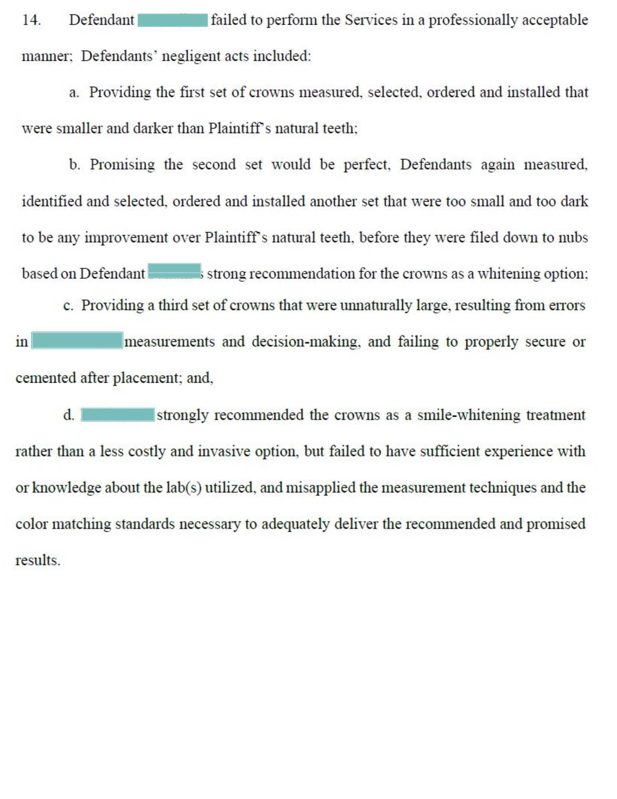
Patient Selection: Case study #2

Slide 33
Patient Selection: Case study #2
Who Controls Treatment?
Patients can request treatment, but they cannot dictate what treatment is to be done.
You are the professional
Patient Communication
Discussion with Patient A re: her initial expectations and why her requested change may not work
If you don't feel comfortable treating a patient due to unrealistic expectations . . . Consider referring elsewhere
Promises
Be careful what you tell patients. It is better to under-promise and over-deliver

Slide 34



The Cosmetic Patient—What Creates a Claim
Promises are Risky
  Advertising strategies often are designed to promise emotional rather than physical results.
  Ads promise an idealized outcome, as opposed to a specific physical result.
  "Past Patient Testimonials" can create unrealistic expectations.
  Distinguish between educational materials vs marketing materials.
Notes:
Dentists who promote themselves as cosmetic specialists must be especially careful that their advertising and marketing strategies don’t promise more than they can deliver. When in the market for “self-improvement,” some prospective patients hear only what they want to hear. For this reason, advertising strategies often are designed to promise emotional rather than physical results.
Examples of slogans that perpetuate emotional promises include:
Change Your Life with a beautiful smile
The power of transformation
Healthy teeth – for life
None of these slogans offers a specific physical result; rather, they promise idealized outcomes. This type of advertising may draw in potential clients, but it also may attract some people whose vision of change is impossible for even the most talented cosmetic dentist to help them achieve.
Further, employees of dental practices that offer cosmetic services — in their eagerness to contribute to the success of the practice — might inadvertently mislead patients by referring to the dentists’ skills or past outcomes with glowing terms that could lead patients to expect the same perfect results, regardless of their individual circumstances. Thus, practice administration should clarify for all members of the team why particular marketing approaches are acceptable and why other tactics are unacceptable.

Slide 35
Cosmetic Patients—Keep Meticulous Records
Cosmetic dentistry is subjective + there are a lot of decisions involved
Document all conversations with patient re: goals + expectations
Baseline charting, exam details, vitality testing, periodontal assessments, oral hygiene, dietary considerations, and noncompliance
X-rays, photographs, and study + diagnostic wax-ups

Slide 36
Patient Selection: Case study #3
Case st dications
Patient
Summary
Outcome
43 YOM, patient A, was "sold" on a veneer treatment plan that involved most of his teeth
.
A presented to Dr. B with an online advertisement he had seen re: veneer treatment, as well as a treatment plan he had received from another dentist.
Dr. B said he could beat the price quote the other dentist gave A. Dr. B noted A did have some periodontal issues involving his gums, but noted he was only there for veneer placement. He told A to ensure he was keeping up on his oral hygiene, but did not advise that A go receive any additional tx for his perio issues.
Dr. B completed the veneer work; the veneers turned out beautifully.
1 year later, A presented to a new dentist due to loose teeth. A ended up needing to have 5 teeth extracted due to periodontal disease.
A sued, and alleged he should have undergone perio tx before beginning cosmetic tx.
Outcome?

Slide 37
Patient Selection: Case study #3
Verdict for Plaintiff
Post-trial commentary from jury members indicated that they believed the dentist fully intended to “double dip” the patient by later selling her bridges or implants for veneered teeth he expected would fail.

Slide 38

Risk strategies: cosmetic procedures
Be candid, honest, and clear about expected results and outcomes for cosmetic procedures.
Discuss during the informed consent process the total length of the plan of care and what the patient can expect visually and physically during that timeline.
Clearly define and discuss the patient’s responsibilities in relation to the plan of care, and get the patient’s agreement.
Be upfront about expected costs and any additional costs that may be associated with changes in the plan of care.
Be aware of the signs of BDD, and have a plan for managing patients who you suspect might have the disorder.

Slide 39
Emergency Patients

Slide 40
Patient Selection: Case study #4
Case st dications
Patient
Summary
The Issue
17 YOM, A, presented as a new patient to Dr. B with a badly decayed and painful Tooth #31. A, a Medicaid patient, presented with his mother.
Due to the complexity of the case, Dr. B, a general dentist, recommended A undergo a surgical extraction to remove #31; Dr. B advised he wanted to refer A to an OMS.
A's mother advised that A was on Medicaid, and his benefits were about to run out, and he would not have time to be seen by an OMS before the benefits ran out.
Dr. B agreed to perform the extraction of #31. The extraction was incredibly difficult, and took Dr. B a significant amount of time.
1 week after the extraction, A returned to Dr. B's office, complaining of R-sided numbness. Ultimately, A and his mother brought a lawsuit against Dr. B for a negligent extraction.
No Good Deed Goes Unpunished
Notes:
This is an emergency situation where finances have now come into play. Our insured, out of the kindness of his heart agreed to undertake the extraction that he really wasn't comfortable with from the start.
We always say that no good deed goes unpunished especially in patient selection cases.

Slide 41
Patient Selection: Case study #4
No Good Deed Goes Unpunished
The standard of care is the standard of care—kindness is not a factor
Scope of Treatment
Do not treat beyond your comfort level.
If referral to a specialist is warranted, refer the patient.
Do not allow patient finances + timelines dictate compromise your professional judgment.
Rushed Timelines
Consider: does treatment need to occur now from a medical perspective, or because the patient wants it to?

Slide 42
Why Emergency Patients Pose Added Risk—
Unanticipated Circumstances—costs, time constraints
Stop-Gap measures may be necessary—potentially unsatisfactory results temporarily
No pre-existing relationship or rapport with patient
Higher anxiety than usual, for patient and dentist:
Patient
Dentist
Interference with pre-planned schedule
Treatment may be required that is beyond insured's specialty or comfort zone
Results may be temporary or patient may want to control outcome
No time to mentally prepare
Disruption of plans
Patients with dental phobias who avoid dentists until there is an emergency

Slide 43
Emergency Patients—Risk Considerations
The ethical standard for emergency care of individuals who are not patients of record is to provide “reasonable arrangements” for their emergency care.
Ensure the patient understands that this is only an episodic
doctor–patient relationship to provide emergent care.
If you have concerns about the level of care needed, or if you suspect “band-aid dentistry,” refer the patient to the local emergency department.
Trust your instincts! If you feel uneasy about providing emergency care to a patient, don’t do it.
Notes:
What if the patient has a significant amount of dental issues, but they only want you to treat the one tooth?

Slide 44
Patient Selection: Case study #5
Case st dications
Patient
Summary
Outcome
59 YOM, A, presented to Dr. B with a broken filling at #15.
A had a regular DDS, who had provided extensive treatment, but A could not get an appointment. Thus, he presented to Dr. B as an emergency patient. Dr. B noted that the #15 filling was dislodged, and A had extensive decay. Dr. B cleaned out #15, and placed a temporary—Dr. B told A that this was a temporary, and he needed to follow-up with his regular dentist for placement of a permanent crown.
A never got the crown. 6 months later, A presented to his general dentist, who advised that A now needed a RCT due to continued decay and infection.
A returned to Dr. B, demanding a refund for the filling she placed. Dr. B advised that the filling was meant to be a temporary solution; A advised he was allegedly never told about this, and sued Dr. B for the necessary RCT on #15.
Issues?

Slide 45
Patient Selection: Case study #5
Case st dications
Patient
Summary
Outcome
59 YOM, A, presented to Dr. B with a broken filling at #15.
A had a regular DDS, who had provided extensive treatment, but A could not get an appointment. Thus, he presented to Dr. B as an emergency patient. Dr. B noted that the #15 filling was dislodged, and A had extensive decay. Dr. B cleaned out #15, and placed a temporary—Dr. B told A that this was a temporary, and he needed to follow-up with his regular dentist for placement of a permanent crown.
A never got the crown. 6 months later, A presented to his general dentist, who advised that A now needed a RCT due to continued decay and infection.
A returned to Dr. B, demanding a refund for the filling she placed. Dr. B advised that the filling was meant to be a temporary solution; A advised he was allegedly never told about this, and sued Dr. B for the necessary RCT on #15.
Issues?

Slide 46
Patient Selection: Case study #5
Follow-Up System Failure
How do you ensure a patient like A returns to her general DDS to get the follow-up care she needs?
Emergency Patient
Dr. B did not have knowledge of patient's dental hx.
Dr. B was rendering band-aid dentistry
Patient A needed significant work done – is Dr. B on the hook for other issues in her mouth?
Communication + Documentation
If something is a temporary fix, make sure it is documented + you follow-up in writing.

Slide 47
Emergency Patients—Common Dental Injury Scenarios
Failure to consider medical comorbidities, allergies, interactions w/ current meds
Follow-Up System Failures—failure to follow-up with patient post-treatment to determine current status or timely respond to patient complaints
Failure to consider the patient's overall dental health; only focusing on at-issue problem

Slide 48
Patient Selection: Case study #6
Case st dications
Patient
Summary
The Issue
45 YOM, A, presented as a new patient to Dr. B with pain at Tooth #5. A was an EAL patient, and completed his paperwork on the practice's Patient History form in Spanish.
Dr. B evaluated A re: his complaints of pain. She noted that #5 was sensitive during the exam, and showed a carious lesion on imaging. Dr. B recommended a filling on #5, to which A consented; the filling was performed that day.
3 weeks after the restoration, A presented to his local urgent care with cc: fever, nausea, and vomiting. He exhibited s/s of a systolic murmur. A was referred to the ER where it was discovered he had bacterial endocarditis, requiring extensive cardiac treatment, including replacement of a pre-existing artificial heart valve.
On A's Patient History form, he indicated he had a pre-existing hx of a heart murmur, with an artificial heart valve, and hx of cardiovascular disease. Dr. B, in her haste to treat A as a new patient, and due to the language barrier, admitted she did not review the self-completed History form, and did not speak with A about his medical hx.
Issues

Slide 49
Patient Selection: Case study #6
EAL Patients
Translation Services
Ensure you have forms available that the patient can understand
Emergency Patients
Need to have enough appointment time with the patient to ensure you can review patient medical health hx and medications
Patient health literacy is different than our own
Follow-Up
Follow-up re: new and emergent patients as to how treatment went

Slide 50
Relationship between problem-focused emergency visits + the failure to diagnose cancer
Medication Reaction
8.70%
Nerve Injury
4.34%
Infection
10.86%

Slide 51
Second Opinion Patients

Slide 52

Why Second Opinion Patients Pose Added Risk—
It is common practice for patients to compare prices or validate the need for treatment.
Another motive is information-seeking for a case against a previous treating dentist.
Be inquisitive about the patient’s motive:
Who is your current dentist?
When were you last seen as a patient?
Why did you select my office?
Why are you seeking a second opinion?
Evasiveness or refusal to answer these simple questions should cause concern in deciding whether to provide the second opinion.
Notes:
2nd opinions are common and necessary in dentistry. It is not uncommon for patients to get a second opinion to check on both the necessity and cost of recommended treatment.
But hidden in 2nd opinions can be information-seeking for a board matter or lawsuit against another practitioner.
Be mindful if you have a patient who can't answer:
Who is your current dentist
When were you last seen
Why did you select my office
Why are you seeking a second opinion
If you have a patient who is evasive or you get a feeling that something is off, maybe pass on taking that patient on.
Goal: You want to avoid being put into a jousting situation.

Slide 53
Second Opinion Patients—Risk Considerations
If you do provide second opinions:
Stick to the facts.
Don’t speculate or guess.
Try to get accurate clinical information.
Try to get both sides of the story; if possible, talk to the previously treating dentist.
Stay clear of any negative commentary.
Avoid JOUSTING
Notes:
If you can get previous treatment records, that is great.
If you are hearing the patient's side of the story and something is not quite right, don't hesitate to pick up the phone and call the previous treatment dentist.
If you are giving your opinion, don't add anything negative about the prior treating physician.

Slide 54
Patient Selection: Case study #7
Patient
Summary
50 YOM A was working a job as a general contractor on insured, Dr. B's, home. A learned Dr. B was a dentist. 1 month after the renovation ended, A showed up at Dr. B's office as a new patient. At no point prior did Dr. B recommend her services.
Dr. B observed that A had rampant decay, extraction of multiple teeth, and placement of crowns and partials by a prior dentist. He was also a smoker.
During the initial visit, Dr. B created a restoration treatment plan including extractions, crowns, and fillings.
A point-blank asked Dr. B if she thought work performed by prior dentist was "shoddy" and asked, in her opinion, whether he "had a case" against prior practitioner.
Dr. B told A she would not comment on care rendered by other practitioner. She undertook restorative treatment on A for over 2 years during which there numerous adherence and clinical issues.

Slide 55
Patient Selection: Case study #7
Case st dications
Outcome
Dr. B had advised A that the best option for him was implant-supported dentures, but A advised he did not want to pay for implants. He discontinued care with Dr. B.
A began treatment elsewhere and continually complained of pain and discomfort sustained from crown and denture work by Dr. B. A indicated to subsequent provider that he "had no issues" until Dr. B began her care.
A ultimately had a subsequent provider author a scathing letter against Dr. B, advising her that her work was improperly performed.
Issues

Slide 56
Patient Selection: Case study #7
Request for Joust
Patient A asked Dr. B if she would provide an opinion/testimony against other dentist—Code Red!
Patient Relationship
Just because you have a pre-existing relationship with a patient does not mean they won't sue you
Treat them as you would any other patient
Documentation
Document patient's condition at the start of treatment—in the event the patient goes elsewhere

Slide 57
New Patients

Slide 58
New Patients—Risk Considerations
Dentists are not obligated to take newcomers. Implement screening criteria, and watch for red flags, such as new patients who:
Complain about previous treatment
Have a history of dentist hopping/shopping
Show up with a plan of care/dictate treatment
they desire
Have a history of nonadherence
Are evasive about previous care or treatment
Refuse to allow access to their dental history

Slide 59
Nonadherent Patients

Slide 60
Patient Selection: Case study #8
Case st dications
Patient
Summary
The Issue
53 YOM patient, A, was referred to insured, Dr. B, an OMS, for a left mandibular cyst. The cyst was followed radiologically, but had recently enlarged, and was causing pain.
Dr. B performed a surgical excision and resection of A's cyst. He sent fragments of the cyst to a pathologist for assessment.
Dr. B scheduled A for a follow-up visit 1 month post-op to check on how he was doing, as well as to discuss the pathologist's findings.
A cancelled his follow-up appointment with Dr. B, and Dr. B's office did not call A to reschedule. A never returned to Dr. B's practice, moved, and established care elsewhere.
8 years later, A developed acute numbness and a L foot drop. He underwent an MRI which revealed a large mass at the L5 vertebral body. A PET Scan revealed metastatic lesions w/in Plf's lumbar spine, sacrum, R 3rd and 4th ribs, sternum, and left mandible. It was subsequently discovered Dr. B failed to fully enucleate the lesion 8 years prior.
Issues

Slide 61
Patient Selection: Case study #8
Dr. B did not have a system in place that would have alerted him to the fact that he was awaiting a pathology report, and needed to follow-up with the patient.
Yes, the patient was nonadherent in that he failed to follow-up . . .
. . . But Dr. B's office failed to have a system in place where they called the patient to schedule a follow-up appointment for the patient.
Further, Dr. B's office needed to explain to the patient why follow-up, in his case, was important.
Further, Dr. B's office did receive the pathology report, indicating the lesion was malignant . . . . Dr. B's office received a fax of the report, and failed to alert Dr. B.

Slide 62
Nonadherent patients—risk considerations
To manage nonadherent patients, you need to consider unique patient circumstances
A patient’s non-adherence, even if discussed and acknowledged, does not absolve you from the potential liability that nonadherence might trigger.
You have the right to terminate the doctor–patient relationship with non-adherent patients as long as you do not violate state or federal laws or contractual obligations.
Ongoing poor dental hygiene (i.e., nonadherence with routine care) has been the precursor to multiple dental malpractice claims.

Slide 63
Nonadherent Patients—unique patient situations
Why are some patients nonadherent?
Health Literacy, in general
Lack of understanding about their diagnosis and treatment
Socioeconomic challenges and cost concerns
Individual traits, including memory and other cognitive challenges
Level communication with healthcare provider about treatment plan
Documentation & Communication is Key
Notes:
Diagnosis: Some people are in denial about their diagnosis or a condition going on (not a priority or don't understand)
Socioeconomic Factors: Monetary or transportation access
Individual Traits: some people may have cognitive or behavioral challenges that make compliance with care difficult, or they're entirely dependent on others to provide that care
Lack of Understanding About Treatment: Patients may not understand the danger of not complying. We'll talk about this in one of our examples, but if you don't know why you're on a 3 month recall for hygiene or a watch on a problematic area, you're less inclined to comply
Communication with Provider: Patients want to feel engaged, and a part of the team. If they don’t feel that way, compliance may be an issue. (More understanding of treatment plan and how it benefits them, more willing to comply)

Slide 64
Nonadherent Patients—system breakdowns affecting adherence
Specialists who do not routinely send consultation reports to referring providers
Radiology results not being made available to an ordering provider
Accessing specialty care may be difficult for patients depending on financial or geographic constraints
Obtaining a timely appointment with a specialist might be difficult due to a shortage of specialists, particularly if the patient is required to schedule his/her own appointment

Slide 65
Patient Selection: Case study #9
Case st dications
Patient
Summary
The Issue
40 YOM, A, presented to Dr. B for a prophy visit. Dr. B noted a lesion on the inside of A's right cheek, and asked if he had been chewing on it. A denied this.
Dr. B advised A he wanted to see him back in 1 month for a recall appointment. A did not return for 3 months. Dr. B observed there was still a slight abnormality on the inside of the cheek. Dr. B advised A to return in 1 month. Dr. B intended to biopsy the area if A returned with an abnormality.
A did not return for 1 year and 7 months. Dr. B's office did not follow-up with A at any point during his absence to reschedule an appointment, or check up on his status.
When A did return, he complained of pain in his jaw and in his gums. Dr. B observed a more prominent lesion on the inside of the A's cheek, and performed a biopsy.
A was diagnosed with squamous cell carcinoma of the jaw, requiring a hemi-mandibulectomy, bone grafting from his leg, chemotherapy, and radiation. A has had two subsequent reoccurrences of his cancer. He has been advised that a third recurrence would likely be fatal.
Issues

Slide 66
Patient Selection: Case study #9
No documented instances by insured or his staff to follow-up with the patient when he missed his subsequent appointments.
Yes, the patient delayed in following up with insured because of travel.
But given the abnormality observed, it was incumbent to the insured to:
Explain why the patient needed to follow-up, and
Call the patient when he did not return and advise him to follow-up.
Had the patient followed-up as necessary, it is likely the lesion could have been resected using less invasive means

Slide 67
Risk Strategies—patient-focused approaches
Establish a policy defining the rights + responsibilities of the patient.
Communication is key—
- Ask open-ended questions
- Use motivational interviewing + the teach-back method
Create a Patient Care Agreement that details the responsibilities of the provider and the patient.
If the patient is missing appointments, try and determine why.
After several appointments have been missed, consider sending a letter to the patient stressing the importance of keeping appointments + consequences of not doing so.

Slide 68
Patient Selection—systems-focused approaches
Review + discuss with care team any patient nonadherence
Identify care coordination barriers to facilitate communication
Ensure effective processes in place to track and follow-up with patients re: outstanding care recommendations
Document missed or cancelled appointments, if possible, document the reason for cancellation
Do not delete original appointment entries
Document a description of clinical nonadherence and any education provided
Be objective
Avoid any disparaging remarks

Slide 69
Disruptive / Abusive Patients

Slide 70
Patient Selection: Case study #10
Case st dications
Patient
Summary
Outcome
67 YOF, A, with poor dentition and broken bridges consulted with insured, Dr. B, a young dentist, for restoration plan.
Dr. B sees A for an initial appointment. During the appointment, A is standoffish and speaks condescendingly about her prior dentist. Dr. B completes a full mouth assessment of A, and begins to prepare both a plan for dealing with A's immediate dental needs, as well as her restoration options.
Dr. B determines that #3 needs an immediate filling. A consents to the procedure. Dr. B administers a mandibular nerve block.
While waiting for A to get numb, A remarks "who is your professional liability carrier? Just in case something goes wrong, I want to know who to sue."
Dr. B, unnerved by A's statement, advises A that she no longer feels comfortable treating her. She advises A's initial exam will be free, but she will not render any further treatment. A sues, alleging battery, and abandonment.
Issues?

Slide 71
Disruptive/Abusive Patients
Everyone immediately becomes on edge
And nobody performs as well when on edge
Staff might get offended
They might feel put in the middle
You might have to take sides, but do so professionally
Other patients might get offended
Is it worth losing other patients?
The schedule falls behind
Angry patients more likely to sue and make Board complaints

Slide 72
Risk Techniques—De-Escalation—2 Time Frames
Preemptive De-Escalation
Reactive De-Escalation
Before you become tied
to the patient
Option after patient's true
colors are shown

Slide 73
Preemptive De-Escalation
Will this be the patient who, when you see their name on the schedule, you cringe?
Think, and re-think, whether you want them to be part of your life
The new employee/assertive supervisor conundrum
It's far easier to (politely and professionally) opt against taking them on, than dismissing
But beware of claims of discrimination
Protected classes
Race
Ethnicity
Certain medical conditions

Slide 74
Preemptive De-Escalation
Preemptive De-Escalation is a tactic to reduce the intensity of a problematic behavior before it escalates.
Are there problematic behaviors from the start?
Consider protected classes and reasons for refusing treatment.
Notes:
Insert reference

Slide 75
Reactive De-Escalation
Disclosure + Apology
Refund
Dismissal

Slide 76
And finally, what about when things don't go well?
Disclosure and Apology
Why?
Patients want it and expect it
Preserves patient trust
Opens dialogue about what’s next
Reduces (not eliminates) the possibility of a lawsuit
Starts the healing process
For patients
For providers
Patients and families hire attorneys because of a lack of information and feelings of betrayal and mistrust
BUT—there's a difference between
"I'm sorry for what you're going through" and
"I'm sorry I made a mistake"

Slide 77
How to disclose an adverse outcome
Make it timely
Discuss current medical status of the patient and anticipated treatment.
Be empathic and offer an apology ("I'm sorry for what you are going through").
Acknowledge that the information currently available is incomplete, and commit to further meetings with the patient/family
Provide simple, concise facts in layman’s terms.

Slide 78
Patient Selection: Case study #11
Case st dications
Patient
Summary
65 YOF patient A presented to insured Dr. B, an endodontist, as an emergent patient for pain surrounding #31.
Dr. B performed an exam, and determined that A had irreversible pulpitis. Dr. B performed a RCT.
The next day, A called Dr. B with complaints of persistent pain and numbness localized to her lower front lip. Dr. B scheduled a visit for A that day. Dr. B took a CBCT, and noted an over-extension of CaOH2 that traveled along the R IAN.
Dr. B then did the following:
Discussed the findings with A in detail;
Explained she needed to see an OMS asap as time was of the essence for recovery;
Called an OMS and microsurgeon and personally set-up appointments for P;
Followed-up with P after each appointment to check in on her status and treatment options proposed by the subsequent treaters

Slide 79
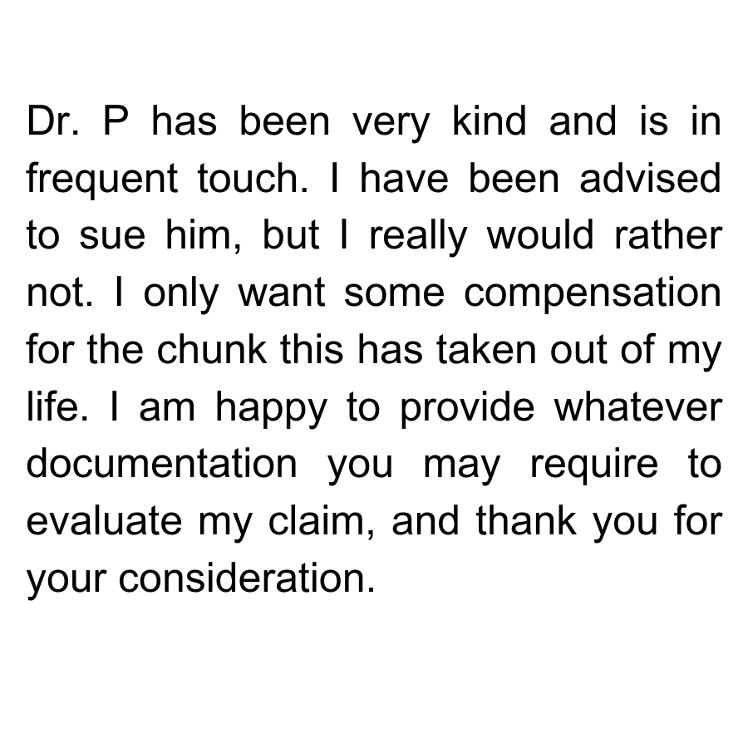
Patient Selection: Case study #11
Case st dicati3s
Outcome
A ultimately did ask Dr. B to assist her with compensation for her subsequent treatment, including a sagittal split osteotomy and nerve decompression.
Her correspondence to MedPro Group in pursuit of her claim included:
While Dr. B, through his insurer, did resolve this claim for the patient, it was for a reasonable amount, and without any litigation for either side.

Slide 80
Refunds—Another tool when things don't go well
Refund
Sometimes they are warranted
They can help to avoid carriers, lawyers, suits
They can be good for community PR and social media reviews
Can naturally facilitate patient dismissal
But
They might not definitively avoid carriers, lawyers, suits
Unless you legally protect yourself with a Release of Liability
A big judgment call
Don't go down that road on your own
Engage with your carrier
Maybe defense counsel needs to get involved
https://www.medpro.com/documents/10502/2837997/Guideline_Refunds+%26+Waivers.pdf

Slide 81
Patient Dismissal
Generally
Timing
30 Days
Yes, dentists can terminate relationships with patients, it is wise for dentists to have objective and factual documentation that supports the decision (e.g. noncompliance)
Need to avoid abandonment: when a healthcare provider terminates a relationship without reasonable notice or in a manner that denies the patient necessary medical care.
Consider:
* Clinical Status
* Is the patient mid-treatment?
* Does the patient need to follow-up?
* Has the patient pre-paid any treatment?
Patients should be given 30 days notice of termination (unless a danger)
In the interim, patients can be seen for emergencies

Slide 82
Patient Dismissal Cont'd
Confidentiality
Questions
Patient confidentiality will be maintained during all conversations and interactions in the office
The practice team members should not be informed of the circumstance under which the patient was terminated from the practice group
If the former patient has any questions about their termination, their call should be forwarded to the appropriate person (i.e. Regional President, RDO, Legal, etc.)

Slide 83
When De-Escalation Does Not Work
The angry patient might say:
“I am going to get an attorney.”
“I am going to complain to the licensing board.”
“I am going to post very negative reviews about you online.”
In all cases, it is reasonable to reply:
“I am sorry you feel that way; we have tried to meet your expectations. We understand that you need to go ahead as your conscience dictates.”

Slide 84
Risk Strategies—Handling Communication Breakdowns
Seek staff input and agreement on the plan, and educate staff about the specifics of the plan.
Identify code words to use during an emergency.
Train staff to execute the plan, including drills, role-playing, etc.
Identify inappropriate and unacceptable behavior, such as offensive language and threats of any type.
Develop a plan for managing complaints to proactively address issues that arise.
Determine who will handle and respond to complaints.
Trend complaint data for use in quality improvement initiatives.

Slide 85
Summary
Implementing an appropriate patient selection process is an effective tool in mitigating the risk of claims and lawsuits.
High-risk patients include those who (a) are seeking cosmetic procedures,
(b) have emergency situations, (c) are seeking second opinions, (d) are new to the practice, (e) are nonadherent with care, and (f) are disruptive or abusive.
Conducting thorough pre-procedure patient assessments is necessary to identify comorbidities and make informed treatment decisions.
If you question the manner in which a patient presents to your practice, or if you have concerns about your ability to properly care for a patient, you should reconsider whether to enter into a doctor–patient relationship.

Slide 86


@MedProDental
dental@medpro.com | 800.4MEDPRO | medpro.com/dentists
Jacqueline Clarke, Esq. 248-216-0644 Jacqueline.Clarke@medpro.com

Slide 87
Resources: Patient Selection
Article: The Challenge of Difficult Patients: Risk Management Strategies for Handling Inappropriate Patient Behaviors www.medpro.com/managing-difficult-patients
Article: Screening New Patients for Potentially Problematic Behavior www.medpro.com/screening-pts-problematic-behavior
Checklist: Terminating a Provider-Patient Relationship www.medpro.com/documents/10502/2899801/Checklist_Terminating+a+Provider-Patient+Relationship.pdf
Guideline: Managing Nonadherent Patients www.medpro.com/documents/10502/2837997/Guideline_Managing+Nonadherent+Patients.pdf
Guideline: Patient Agreements in Clinical Practice www.medpro.com/documents/10502/2837997/Guideline_Patient+Agreements+in+Clinical+Practice.pdf
Guideline: Terminating a Provider-Patient Relationship www.medpro.com/documents/10502/2837997/Guideline_Terminating+a+Provider-Patient
+Relationship.pdf

